Slide 1

Data Science
TEAM PROJECT
The Correlation Between Sleep Habits and Stress Levels
Team #5
Kim Semin, Oh Jinwoo

Slide 2
Contents
01
Introduction
04
Methodology
02
Research Objective
05
Findings & Analysis
03
Dataset
06
Demo Images

Slide 3

01
Introduction
Same Situation
Individual Variation in Stress Response
Sleep
Habits
Final Exam
Notes:
People experience different levels of stress when facing the same situation.
For example, before taking an important exam, one person may remain calm while another might suffer from intense anxiety. Such variations in stress responses suggest that individual factors, such as sleep habits, could play a crucial role.
Recent studies indicate that poor or irregular sleep can negatively impact emotional regulation and increase stress sensitivity. Despite this, the specific relationship between personal sleep patterns and situational stress remains underexplored in practical applications.

Slide 4
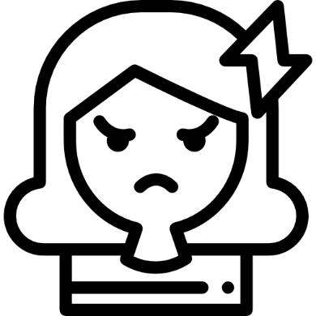
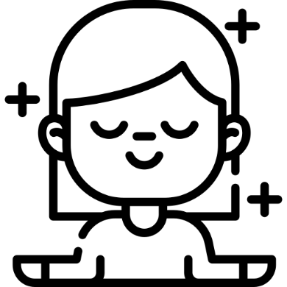
01
Introduction
Same Situation
Individual Variation in Stress Response
Sleep
Habits
Final Exam
Stressful Mild
Notes:
People experience different levels of stress when facing the same situation.
For example, before taking an important exam, one person may remain calm while another might suffer from intense anxiety. Such variations in stress responses suggest that individual factors, such as sleep habits, could play a crucial role.
Recent studies indicate that poor or irregular sleep can negatively impact emotional regulation and increase stress sensitivity. Despite this, the specific relationship between personal sleep patterns and situational stress remains underexplored in practical applications.

Slide 5
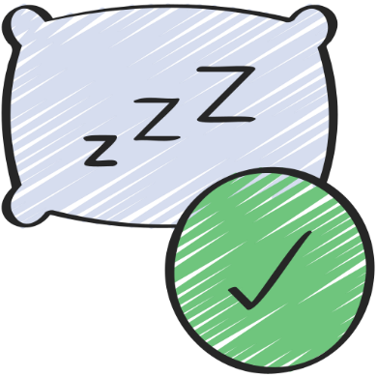
01
Introduction
Same Situation
Individual Variation in Stress Response
Sleep
Habits
Final Exam
Stressful Mild
Sleep Habits
Notes:
People experience different levels of stress when facing the same situation.
For example, before taking an important exam, one person may remain calm while another might suffer from intense anxiety. Such variations in stress responses suggest that individual factors, such as sleep habits, could play a crucial role.
Recent studies indicate that poor or irregular sleep can negatively impact emotional regulation and increase stress sensitivity. Despite this, the specific relationship between personal sleep patterns and situational stress remains underexplored in practical applications.

Slide 6
02
Research Objective
Analyze
Analyze how sleep habit affect stress responses
Predictive Model
Build a predictive model that estimates expected stress levels based on an individual's sleep data
Recommendation
Recommend sleep habit counseling when high stress levels are predicted based on sleep patterns

Slide 7
02
Research Objective
Analyze
Analyze how sleep habit affect stress responses
Predictive Model
Build a predictive model that estimates expected stress levels based on an individual's sleep data
Recommendation
Recommend sleep habit counseling when high stress levels are predicted based on sleep patterns

Slide 8
02
Research Objective
Analyze
Analyze how sleep habit affect stress responses
Predictive Model
Build a predictive model that estimates expected stress levels based on an individual's sleep data
Recommendation
Recommend sleep habit counseling when high stress levels are predicted based on sleep patterns

Slide 9
03
Dataset
Dataset Source (From Kaggle.com)
- https://www.kaggle.com/datasets/orvile/stress-and-sleep-patterns
Gender / Age
[Questions about mental health problems and sleep time]
- Have you ever been diagnosed with a mental health condition by a professional
(doctor, therapist, etc.)?
- Have you ever received treatment/support for a mental health problem?
- When have you usually gone to bed in the past month?
- How long has it taken you to fall asleep each night in the past month?
- What time have you usually gotten up in the morning in the past month?
- How many hours of actual sleep did you get on an average for the past month?
(maybe different from the number of hours spent in bed)

Slide 10
03
Dataset
Gender / Age
[Questions about mental health problems and sleep time]
- Have you ever been diagnosed with a mental health condition by a professional
(doctor, therapist, etc.)?
- Have you ever received treatment/support for a mental health problem?
- When have you usually gone to bed in the past month?
- How long has it taken you to fall asleep each night in the past month?
- What time have you usually gotten up in the morning in the past month?
- How many hours of actual sleep did you get on an average for the past month?
(maybe different from the number of hours spent in bed)

Slide 11
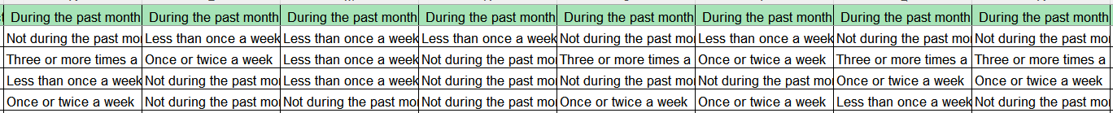
03
Dataset
[Questions about having trouble sleeping]
- During the past month, how often have you had trouble sleeping because you
1. Cannot get to sleep within 30 minutes
2. Wake up in the middle of the night or early morning
3. Cough or snore loudly
4. Feel too cold
5. Feel too hot
6. Have bad dreams
7. Have pain

Slide 12
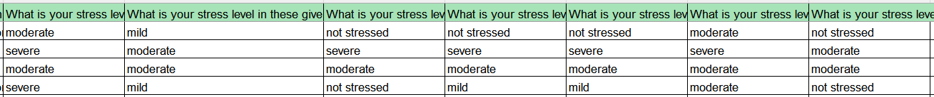
03
Dataset
[Questions about stress level]
- What is your stress level in these given situations
1. An assignment in less than a day
2. A week before exams
3. Asking for an extra ketchup packet at a restaurant
4. Meeting a new person
5. Asking for help
6. Confronting someone
7. Doing something without help

Slide 13
04
Methodology
Data Preprocessing Steps
04-1.
04-2.
Model Design

Slide 14
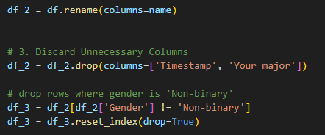
04-1
Data Preprocessing Steps
Column Cleanup
Renaming columns, removing irrelevant features, and filtering out outliers
String-to-Numeric Conversion
Converted categorical answers (e.g., stress and sleep issues) into numerical scores based on common-sense weighting
Feature Aggregation
Created total scores and applied weighted mappings to key sleep behavior features
Stress Level Classification
Defined binary labels (High / Low) based on total stress score.

Slide 15
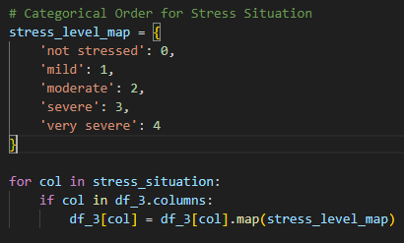
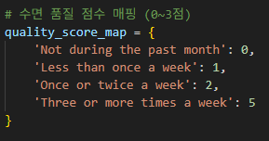
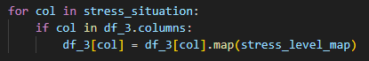
04-1
Data Preprocessing Steps
Column Cleanup
Renaming columns, removing irrelevant features, and filtering out outliers
String-to-Numeric Conversion
Converted categorical answers (e.g., stress and sleep issues) into numerical scores based on common-sense weighting
Feature Aggregation
Created total scores and applied weighted mappings to key sleep behavior features
Stress Level Classification
Defined binary labels (High / Low) based on total stress score.

Slide 16
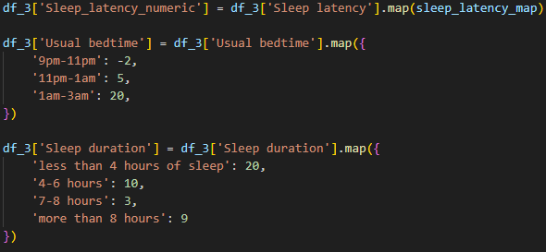
04-1
Data Preprocessing Steps
Column Cleanup
Renaming columns, removing irrelevant features, and filtering out outliers
String-to-Numeric Conversion
Converted categorical answers (e.g., stress and sleep issues) into numerical scores based on common-sense weighting
Feature Aggregation
Created total scores and applied weighted mappings to key sleep behavior features
Stress Level Classification
Defined binary labels (High / Low) based on total stress score.

Slide 17
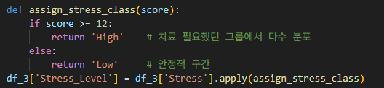
04-1
Data Preprocessing Steps
Column Cleanup
Renaming columns, removing irrelevant features, and filtering out outliers
String-to-Numeric Conversion
Converted categorical answers (e.g., stress and sleep issues) into numerical scores based on common-sense weighting
Feature Aggregation
Created total scores and applied weighted mappings to key sleep behavior features
Stress Level Classification
Defined binary labels (High / Low) based on total stress score.

Slide 18
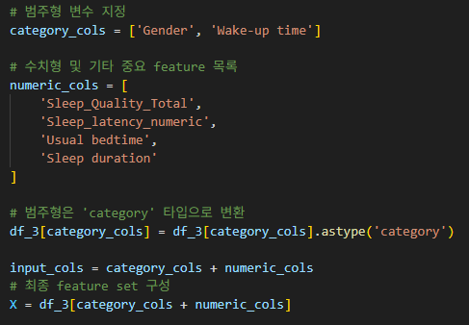
04-2
Model Design
Feature Selection
Selected key features related to sleep and categorical factors
Label Definition
Target variable: Stress Level
- High if score ≥ 12 → Counseling recommended
- Low if score < 12 → Stable
Train-Test Split
Data split into training (80%) and testing (20%) sets
Used train_test_split() from scikit-learn
Model Choice:
LightGBM Classifier
Decision tree-based boosting model
Fast training and well-suited for small tabular data

Slide 19
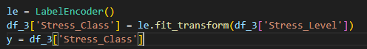
04-2
Model Design
Feature Selection
Selected key features related to sleep and categorical factors
Label Definition
Target variable: Stress Level
- High if score ≥ 12 → Counseling recommended
- Low if score < 12 → Stable
Train-Test Split
Data split into training (80%) and testing (20%) sets
Used train_test_split() from scikit-learn
Model Choice:
LightGBM Classifier
Decision tree-based boosting model
Fast training and well-suited for small tabular data

Slide 20
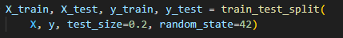
04-2
Model Design
Feature Selection
Selected key features related to sleep and categorical factors
Label Definition
Target variable: Stress Level
- High if score ≥ 12 → Counseling recommended
- Low if score < 12 → Stable
Train-Test Split
Data split into training (80%) and testing (20%) sets
Used train_test_split() from scikit-learn
Model Choice:
LightGBM Classifier
Decision tree-based boosting model
Fast training and well-suited for small tabular data

Slide 21
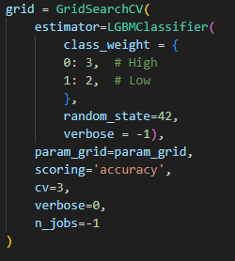
04-2
Model Design
Feature Selection
Selected key features related to sleep and categorical factors
Label Definition
Target variable: Stress Level
- High if score ≥ 12 → Counseling recommended
- Low if score < 12 → Stable
Train-Test Split
Data split into training (80%) and testing (20%) sets
Used train_test_split() from scikit-learn
Model Choice:
LightGBM Classifier
Decision tree-based boosting model
Fast training and well-suited for small tabular data

Slide 22
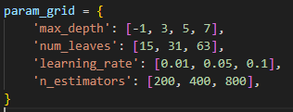
04-2
Model Design
Hyperparameter Tuning
Performed tuning using GridSearchCV
Model Evaluation
Evaluated with classification_report
Checked accuracy, precision, and recall on test set
Real-Time
Prediction Function
New input → Stress prediction → Simple message:
“Maintain habits” or “Counseling recommended”

Slide 23
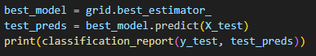
04-2
Model Design
Hyperparameter Tuning
Performed tuning using GridSearchCV
Model Evaluation
Evaluated with classification_report
Checked accuracy, precision, and recall on test set
Real-Time
Prediction Function
New input → Stress prediction → Simple message:
“Maintain habits” or “Counseling recommended”

Slide 24
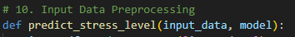
04-2
Model Design
Hyperparameter Tuning
Performed tuning using GridSearchCV
Model Evaluation
Evaluated with classification_report
Checked accuracy, precision, and recall on test set
Real-Time
Prediction Function
New input → Stress prediction → Simple message:
“Maintain habits” or “Counseling recommended”

Slide 25
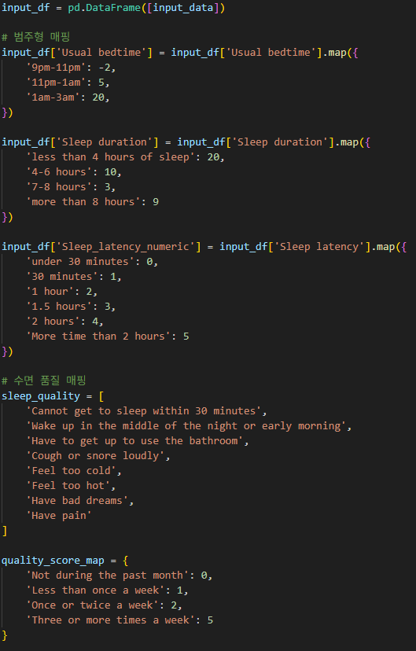
04-2
Model Design
Hyperparameter Tuning
Performed tuning using GridSearchCV
Model Evaluation
Evaluated with classification_report
Checked accuracy, precision, and recall on test set
Real-Time
Prediction Function
New input → Stress prediction → Simple message:
“Maintain habits” or “Counseling recommended”

Slide 26
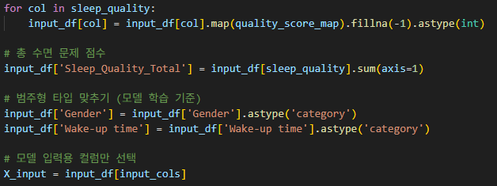
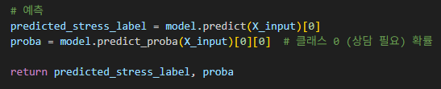
04-2
Model Design
Hyperparameter Tuning
Performed tuning using GridSearchCV
Model Evaluation
Evaluated with classification_report
Checked accuracy, precision, and recall on test set
Real-Time
Prediction Function
New input → Stress prediction → Simple message:
“Maintain habits” or “Counseling recommended”

Slide 27
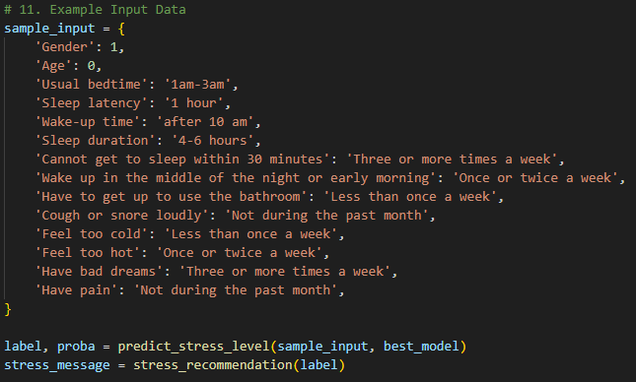
04-2
Model Design
Hyperparameter Tuning
Performed tuning using GridSearchCV
Model Evaluation
Evaluated with classification_report
Checked accuracy, precision, and recall on test set
Real-Time
Prediction Function
New input → Stress prediction → Simple message:
“Maintain habits” or “Counseling recommended”

Slide 28
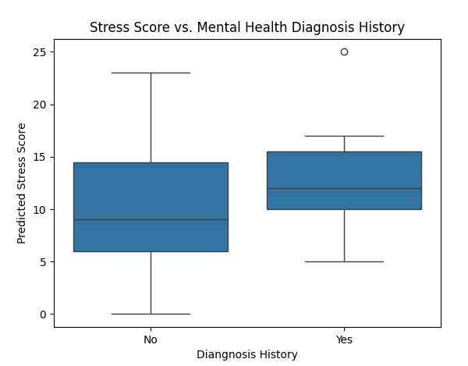

05
Findings & Analysis
Stress Score & Mental Health Diagnosis
Participants with a history of mental health diagnosis had higher median stress scores (≈12.5–13)
Participants without such history had lower scores (≈9)

Slide 29
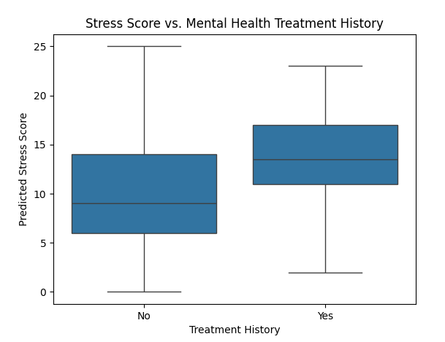
05
Findings & Analysis
Stress Score & Mental Health Treatment
Those who received treatment had a median score ≈14, with 75% reaching up to 17
Those without treatment had lower and more spread-out scores (median ≈8~9)

Slide 30
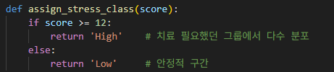
05
Findings & Analysis
Threshold for Risk Classification
Based on distribution analysis, a threshold of 12 was chosen to define:
- High stress → recommend counseling
- Low stress → considered stable

Slide 31
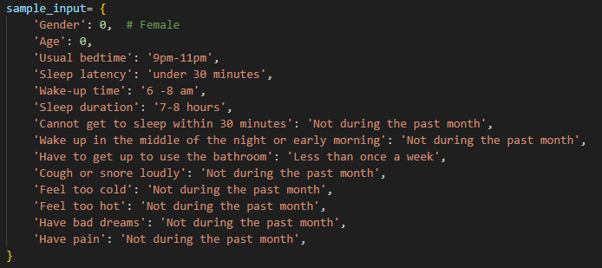
06
Demo Images
Sample input – Healthy sleep habits

Slide 32
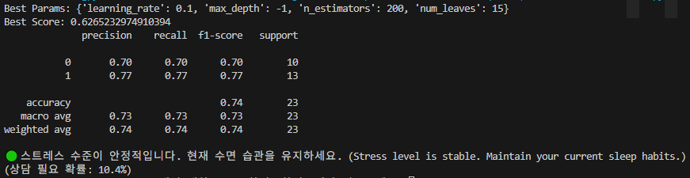
06
Demo Images
Model Performance & Example Prediction
Predicted Class: Low Stress
Probability of needing Counseling: 10.4%
→ Message “Stress level is stable. Maintain your current sleep habits"

Slide 33
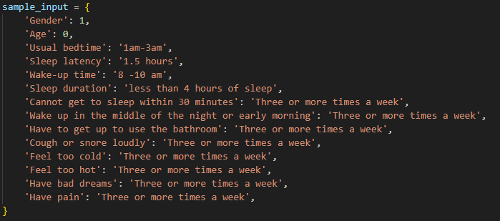
06
Demo Images
Sample input – Poor sleep habits

Slide 34
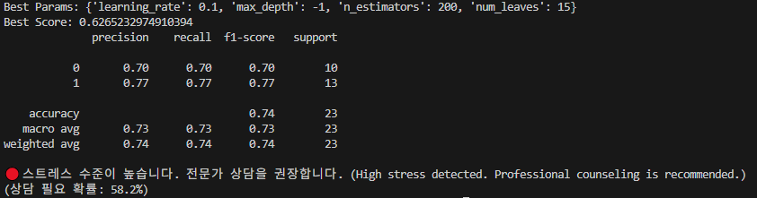
06
Demo Images
Model Performance & Example Prediction
Predicted Class: High Stress
Probability of needing Counseling: 58.2%
→ Message “High stress detected. Professional counseling is recommended."

Slide 35
07
Resources & Credits
Dataset by Kaggle
- https://www.kaggle.com/datasets/orvile/stress-and-sleep-patterns
Presentation template by Canva
- https://www.canva.com/
Icons by Flaticon
-https://www.flaticon.com/kr/

Slide 36


